Slide 1
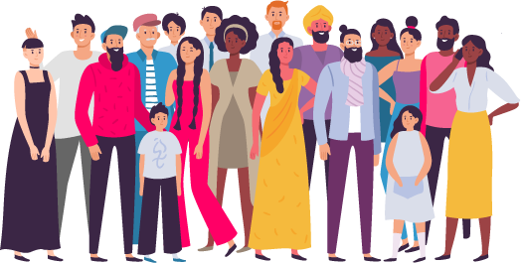
TO LEARN ABOUT INTERSECTIONALITY

Slide 2
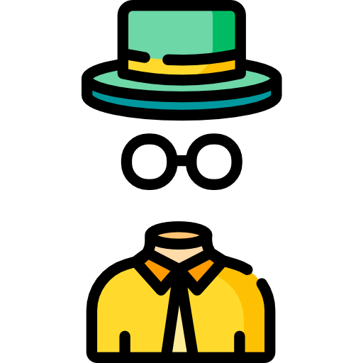
WOULD YOU RATHER
Be invisible
Have super strength

Slide 3
OBJECTIVES
Discuss intersectionality
Learn about identity, privilege, and marginalized populations
Reflect on how you can choose to learn about intersectionality

Slide 4
WHAT IS INTERSECTIONALITY?
Intersectionality is a term that was first introduced by scholar and civil rights advocate Kimberlé Crenshaw in 1989.
To understand intersectionality, you must look at the different parts of people’s identities, and how these intersecting identities can cause folks to experience life different from others.
Identities can sometimes create barriers and challenges that can place people at a disadvantage.

Slide 5
WHAT IS INTERSECTIONALITY?
Some choices you can make to get involved in your community include:
You can make a choice to recognize these dynamics faced by folks with intersecting identities.
On the other hand, you can also look at how these identities can allow people to have privilege in society.
Let's discuss this in more detail.

Slide 6
MARGINALIZED POPULATIONS
Marginalized populations are groups and communities that experience discrimination and inequality. Some examples include:
Senior citizens
People with disabilities
LGBTQ (Gay, Lesbian, Transgender, and Queer)
BIPOC folks (Black, Indigenous, People of Color)
Women

Slide 7
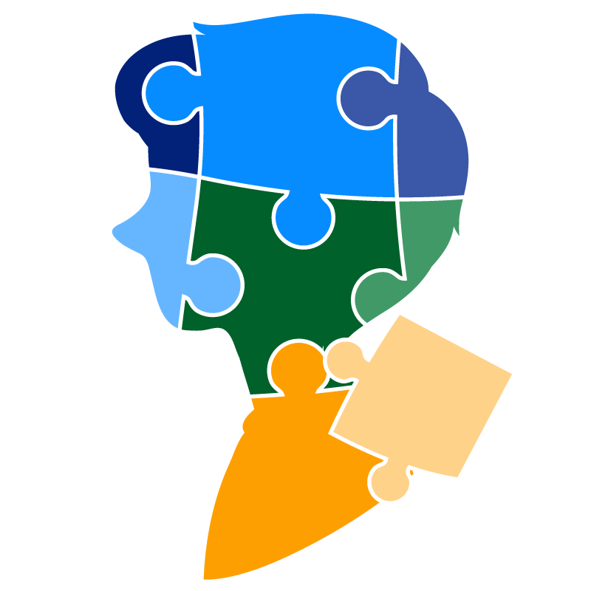
WHAT MAKES UP OUR IDENTITY?
Race
Gender
Age
Class
Socioeconomic status
Legal status
Sexual orientation
Religion
Physical or mental ability

Slide 8
PRIVILEGE
We need to make a choice to understand privilege. Privilege happens when people experience advantages simply because of their identity. For example:
A person with no mobility problems has privilege because it is easier for them to get around in public compared to many people who do have a mobility issue.
A person who is “average” height and weight has privilege when getting on an airplane because they can move easier through the aisle than someone who is very tall or very wide.
There are many other examples of how someone has privilege.

Slide 9
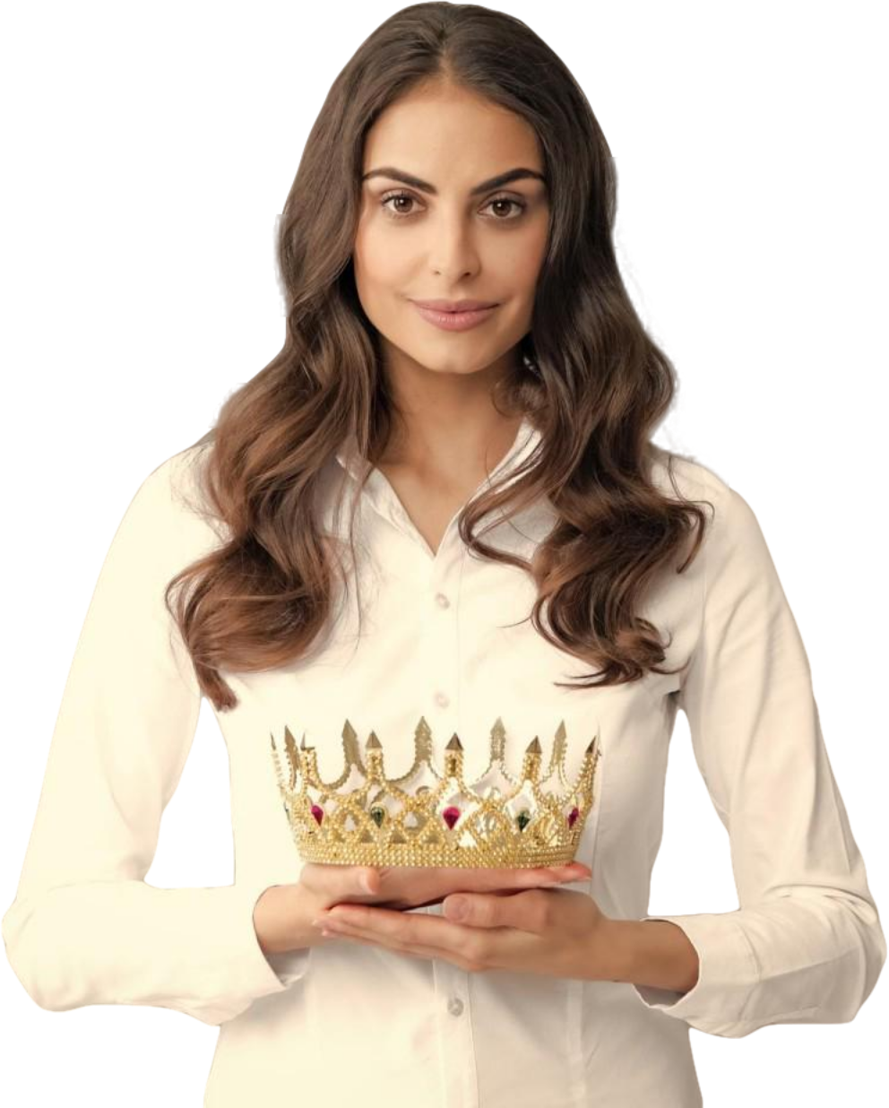
What are other ways you can
have privilege?
DISCUSSION

Slide 10
WHY IS INTERSECTIONALITY IMPORTANT?
Notes:
https://youtu.be/3qhadch9oDo

Slide 11
Why is it important to recognize our own privileged identities?
DISCUSSION
How can you use your privileged identities to speak up for others?
How can you practice being an intersectional feminist?

Slide 12
MAKE A CHOICE!
Making a choice to learn about your identity is important because it will give you a better view of how you and others experience the world.
By learning about intersectionality, you can create a better understanding that sometimes people may be placed at a disadvantage because they hold different identities.
You will get to learn that in order to bring equality you must work through all issues.

Slide 13
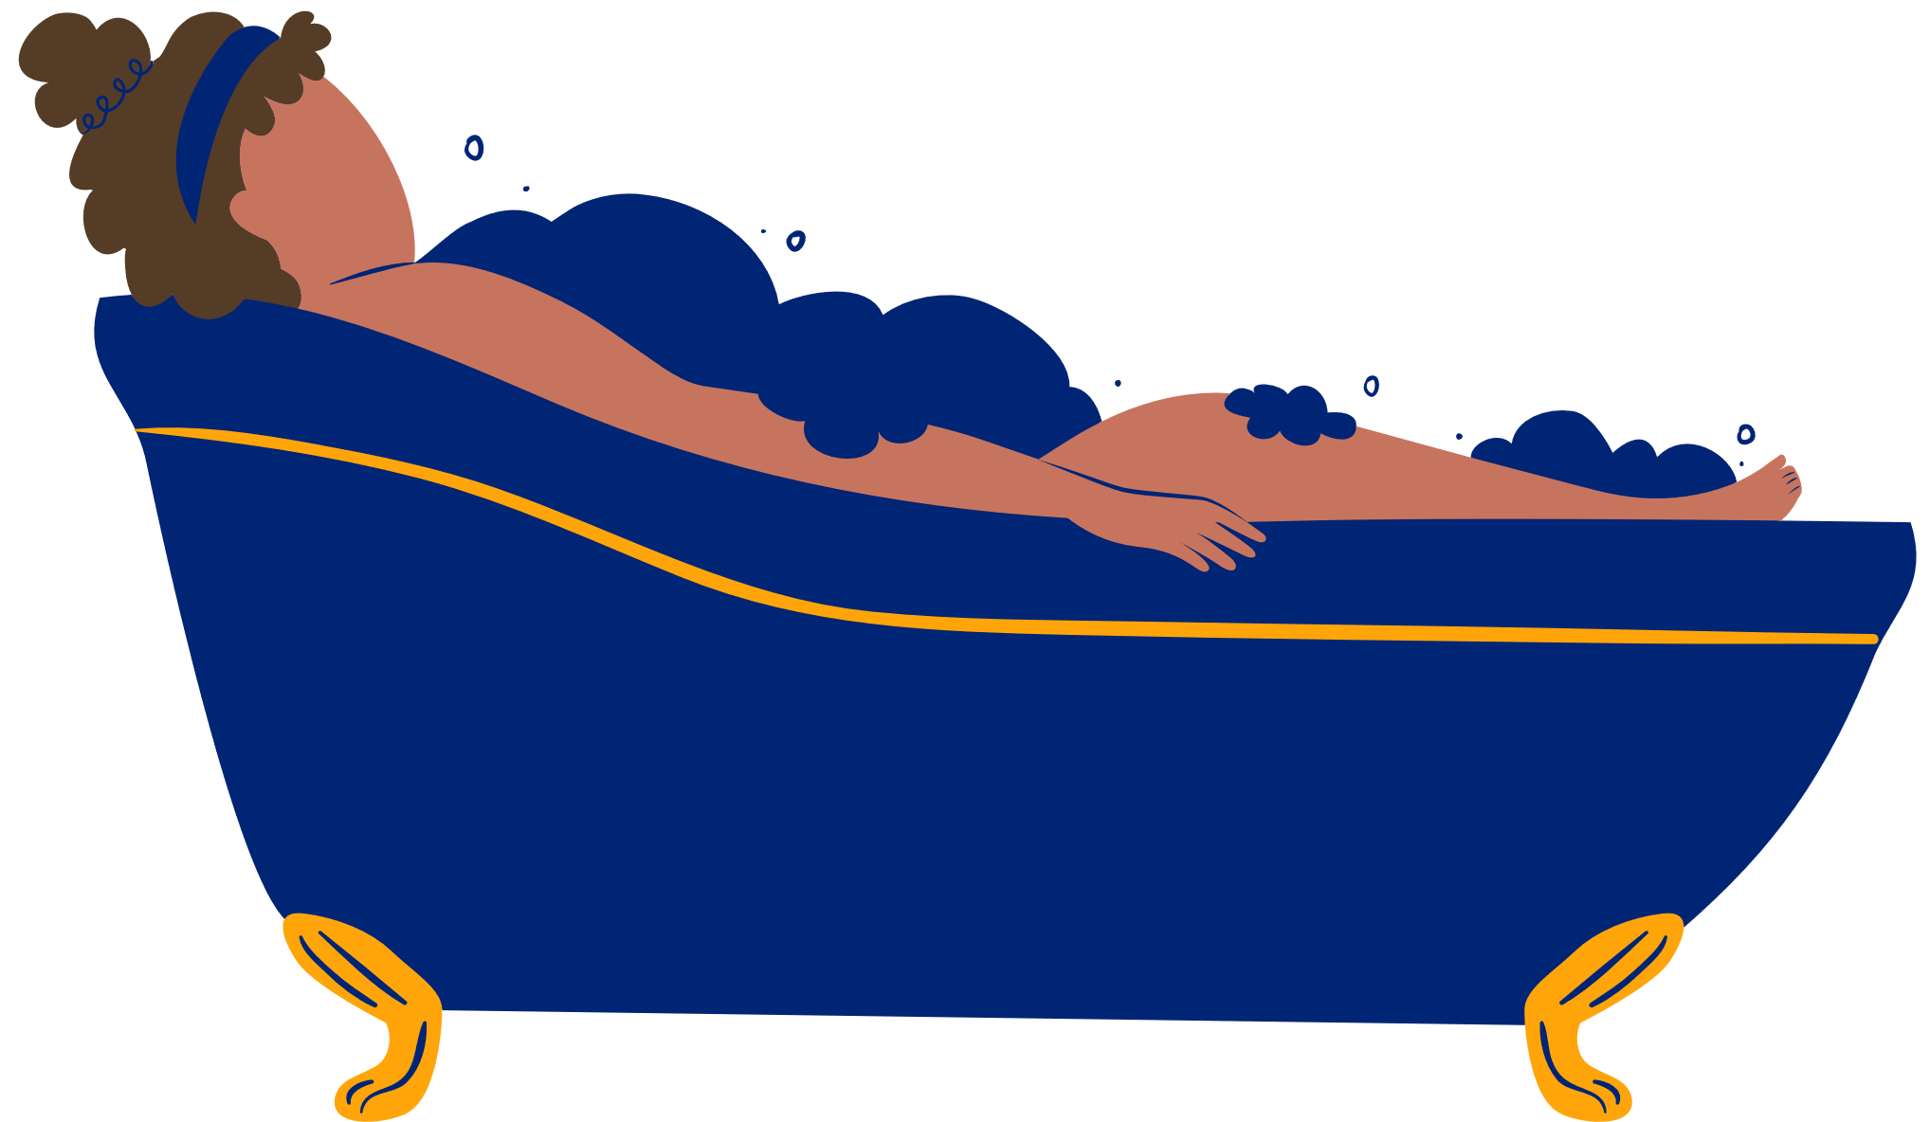
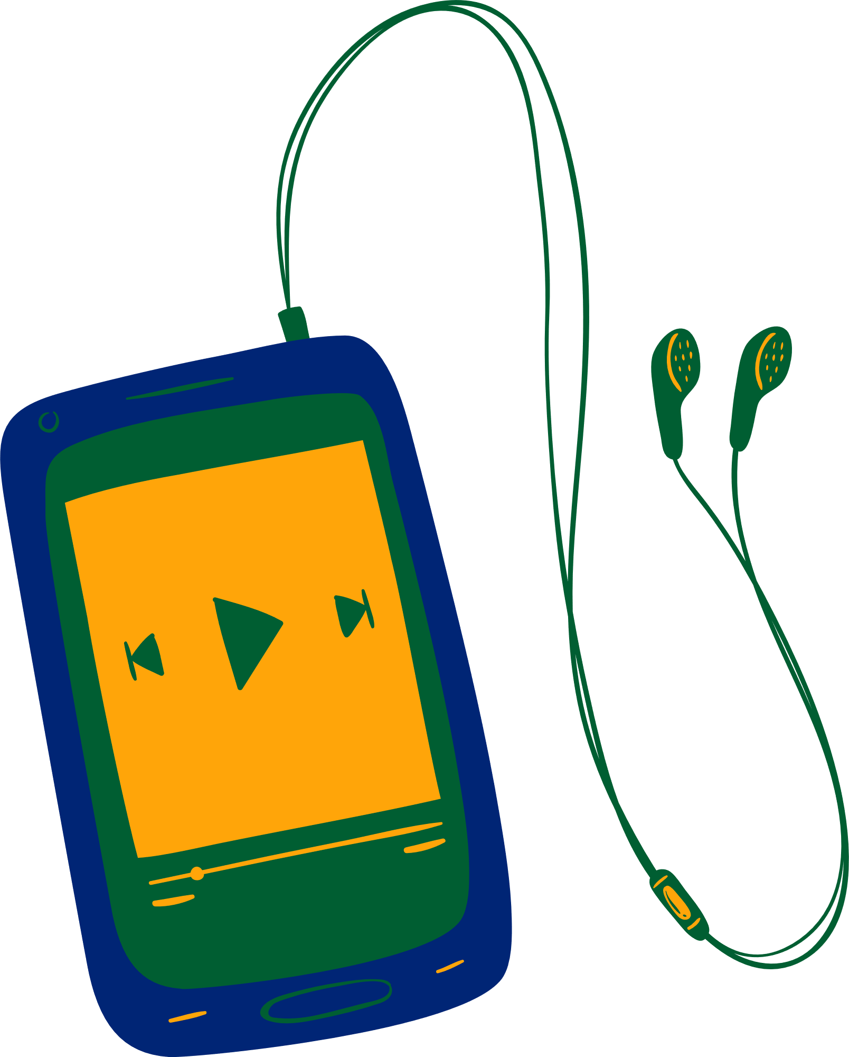
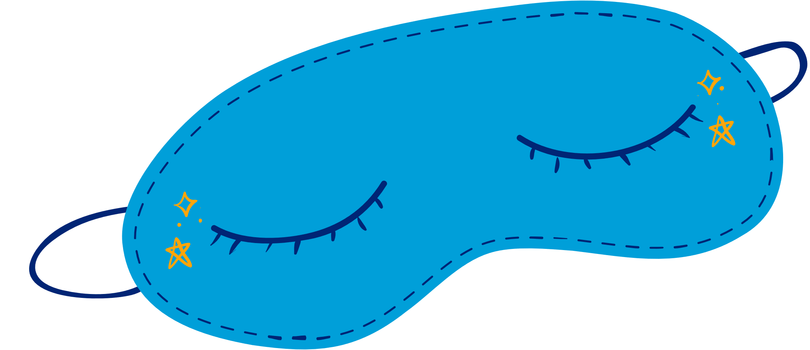
CHECK OUT
What will you do for yourself today?
Take a Bath
Listen to Music
Read a Book
Call a Friend
Enjoy Nature
Take a Nap

Slide 14
Committed to fostering a safe and respectful District, school and community culture where the seeds of peace and justice are sown so that all students and staff can lead safe, purposeful and academically fruitful lives.
Connect with us at bit.ly/LAUSD-HRDE

